Slide 1
Task 3
By:
Prachi Hiware

Slide 2
Report:
Title: Cross Site Scripting.
Domain: Vulnweb.com
Subdomain: testasp.vulnweb.com
Summary:
The website was built with the intention to test the Acunetix Web Vulnerability Scanner. For this reason this website have lot of bugs to demonstrate the fore mentioned software's capabilities to find those bugs.
Securing a company's web applications is today's most overlooked aspect of securing the enterprise. Web application hacking is on the rise with as many as 75% of cyber attacks done at web application level or via the web. Most corporations have secured their data at the network level, but have overlooked the crucial step of checking whether their web applications are vulnerable to attack. Web applications, which often have a direct line into the company's most valuable data assets, are online 24/7, completely unprotected by a firewall and therefore easy prey for attackers.

Slide 3
Steps to Reproduce:
To reproduce,the attacker has to:
Step 1: Visit http://testasp.vulnweb.com/
Step 2: On the top menu you will find a search option.
Step 3: Click on it and you will be prompted with the Search box.
Step 4: Can intercept the request in Burp Suite
Step 5: Now you can find different payloads for XSS.
Step 6: Send the request to the intruder and paste all the payloads.
Step 7: Try to find a successful payload for XSS.

Slide 4
Impact:
Cross-Site Scripting (XSS) attacks are a type of injection, in which malicious scripts are injected into otherwise benign and trusted websites. XSS attacks occur when an attacker uses a web application to send malicious code, generally in the form of a browser side script, to a different end user. Flaws that allow these attacks to succeed are quite widespread and occur anywhere a web application uses input from a user within the output it generates without validating or encoding it.An attacker can use XSS to send a malicious script to an unsuspecting user.
Mitigation:
If you want to prevent your website to be vulnerable of Cross Site Scripting, then you can enable noscript on browser.
POC including screen recording and screen shots is included in the report which is attached below.
Image1.png
Image2.png
Image3.png
Video.mp4

Slide 5
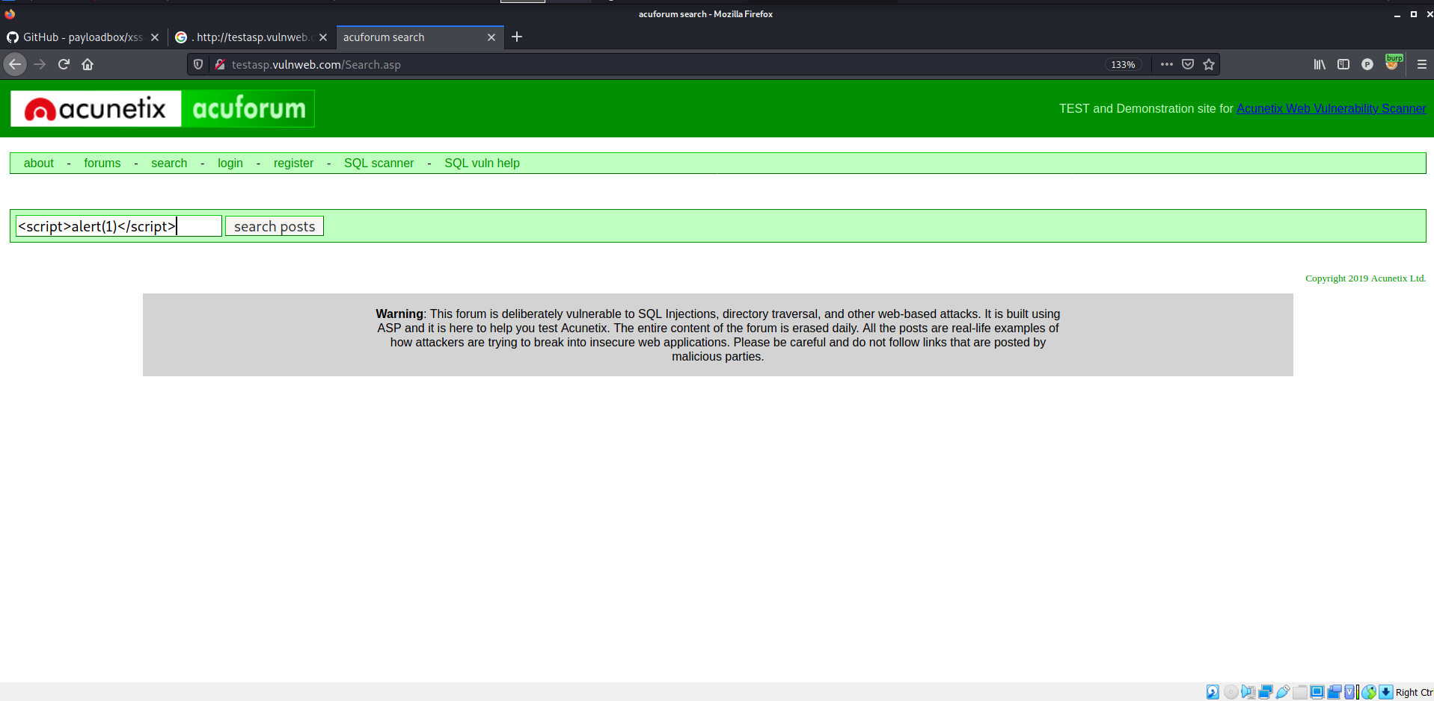
Image 1

Slide 6
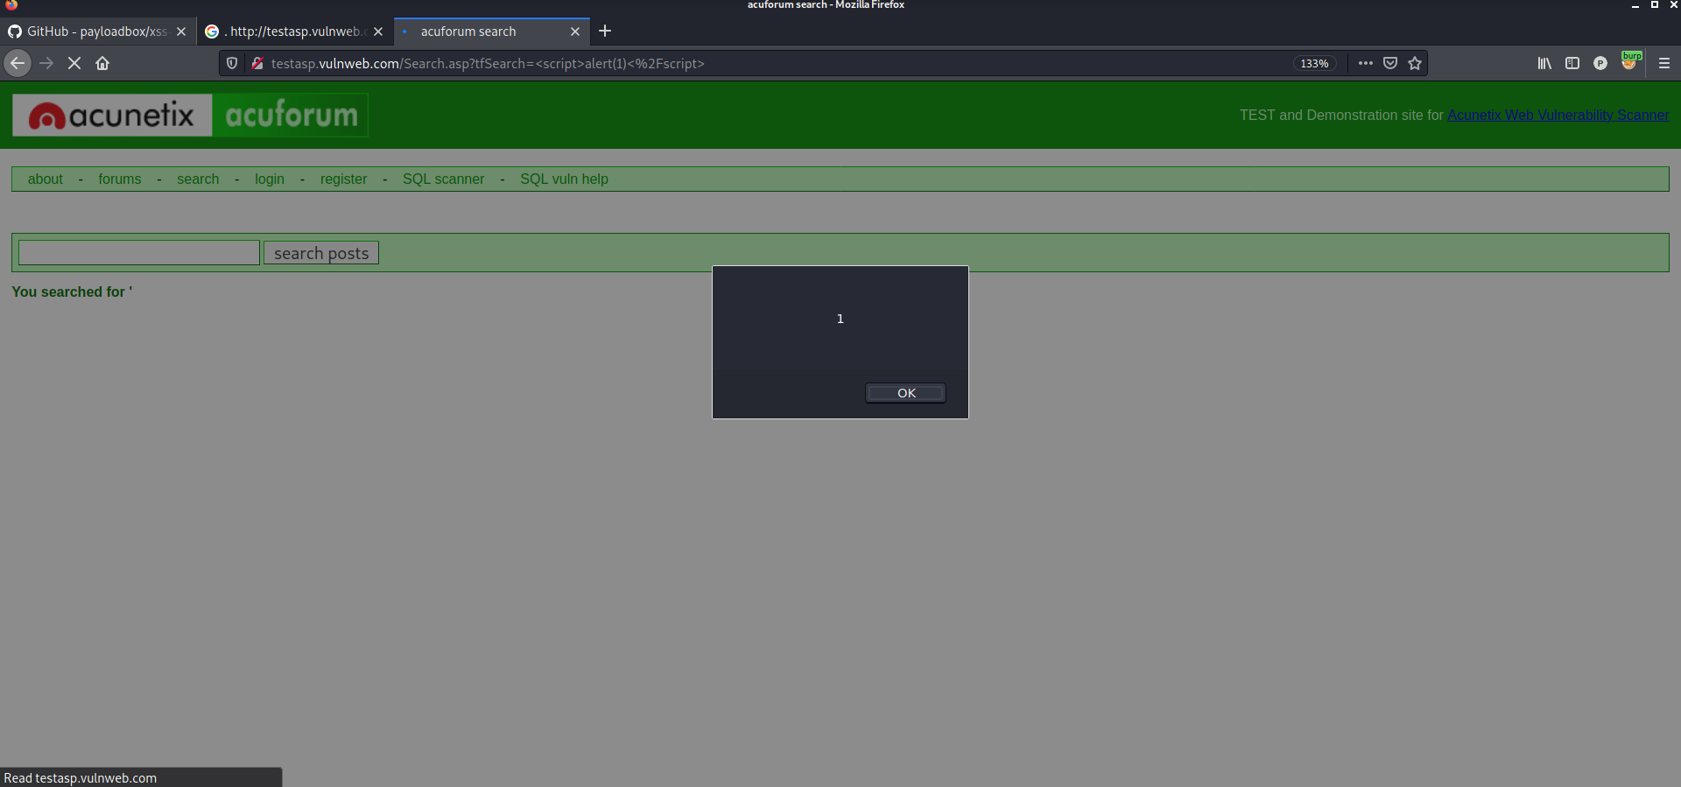
Image 2

Slide 7
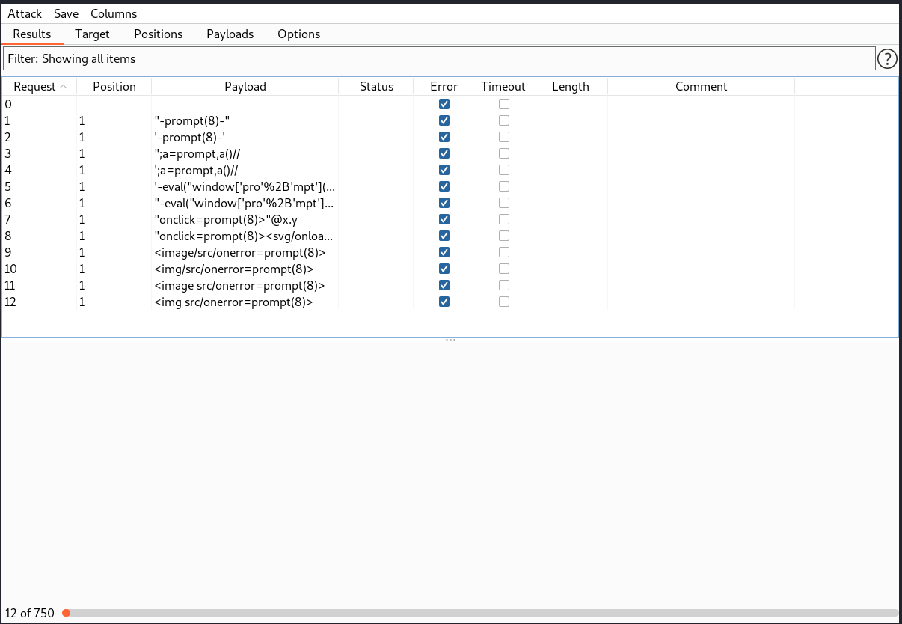
Image 3

Slide 8
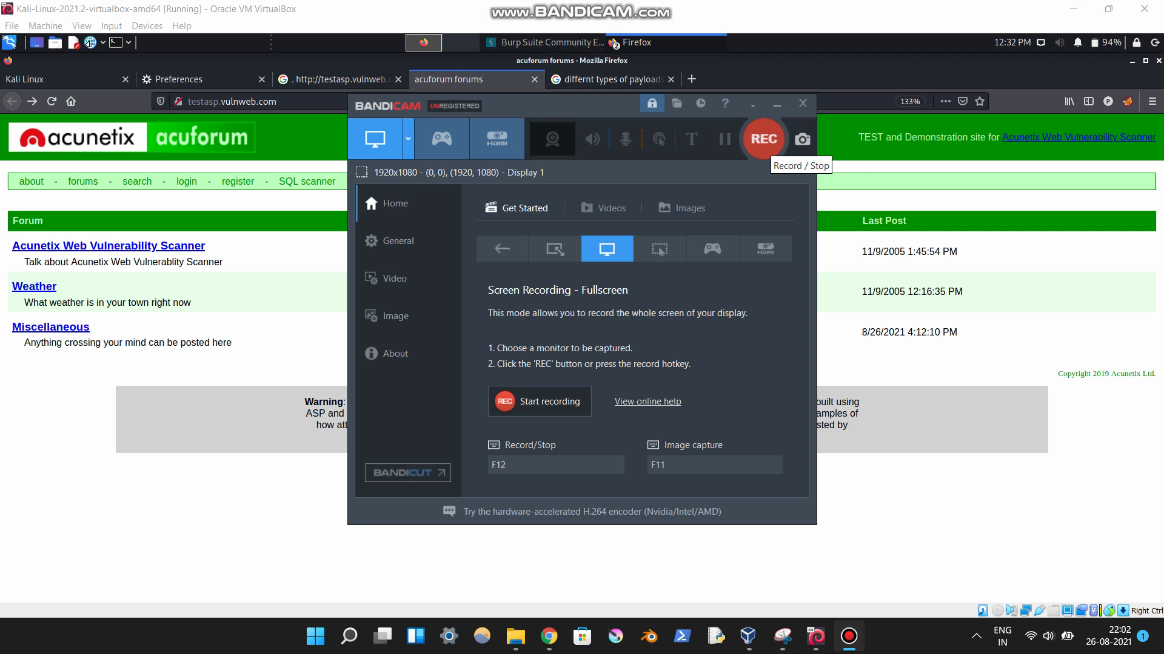
Video 1

